Slide 1

Weekly Report: Week 1
GSP Team B

Slide 2

Progress
A visual representation of our timeline and progress should be shown here

Slide 3

Team Activity
Graphs and statistics on team activity and performance should go here

Slide 4

Summary
Any changes we have made in our plan since last time should be addressed here if they are relevant details.

Slide 5

Team Member Presentations
Sam and Blaine – concept level design 2 weeks
Josh - UI concept 1 week
Bronwyn – Weapons concepts 2 weeks
Bailey – enemy concepts 2 weeks
Dan and Owen – Learning blueprints and researching grapple mechanics
At this point each team member must present what they have been doing over the past week, so I advise using screenshots and 1 slide each.
Also include what your next weeks plans are.

Slide 6
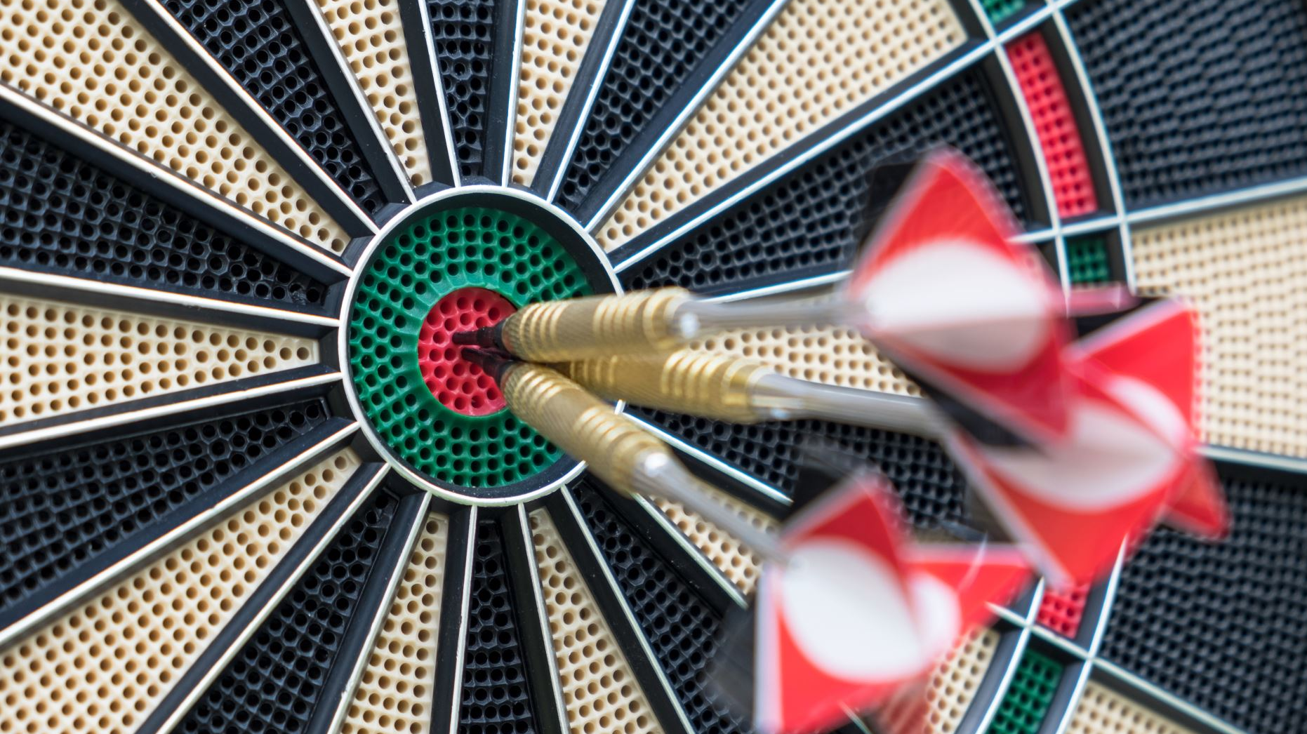
Next Weeks Targets
An overall summary of the next weeks goals should be made here. Relate it to timeline.

Slide 7

Challenges
Any issues that may hinder progress should be listed here.

Slide 8

Anything We Need Help With?
Any questions we have or advice we need should be asked for here

